Slide 1
TRIO
Ronald E. McNair Post-Baccalaureate Scholars Program
Presentation to Faculty Senate
November 29, 2022
Strategic Enrollment Management
and Student Success & The Graduate School

Slide 2
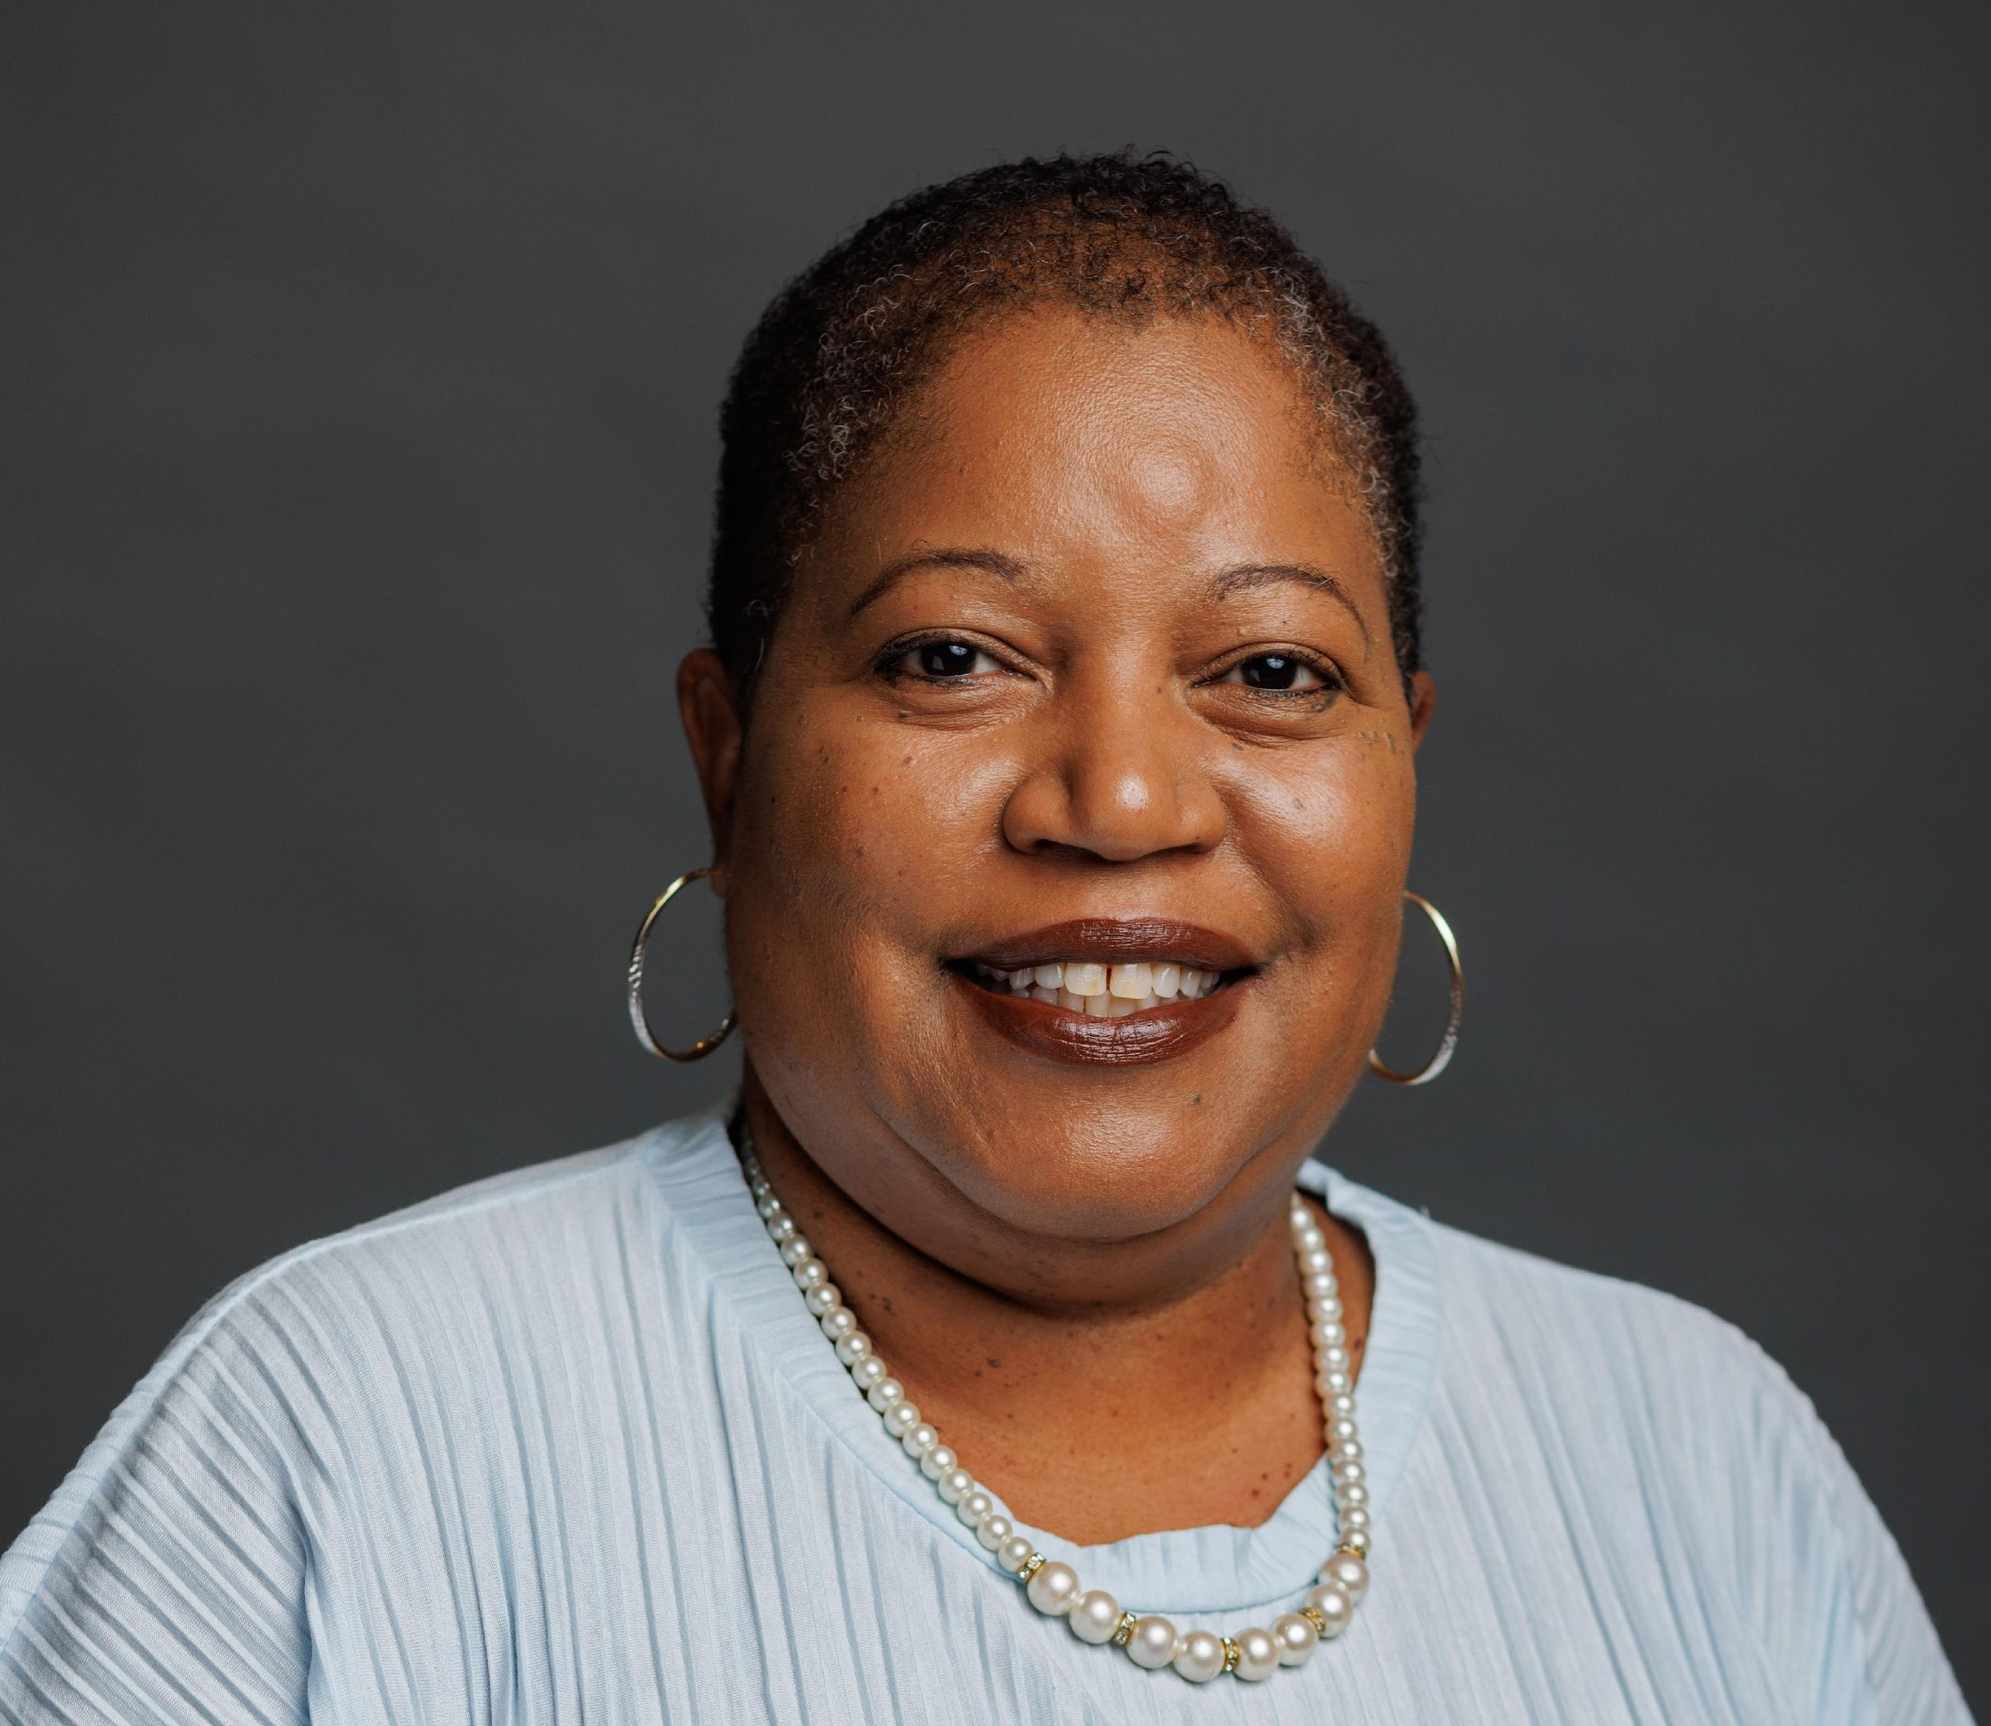
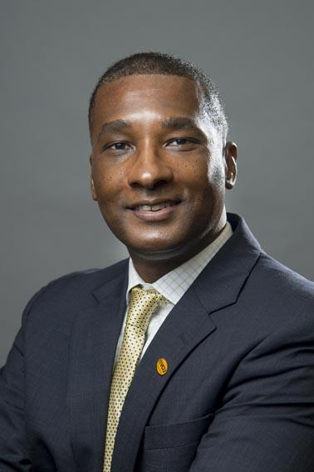
McNair Staff Introductions
Dr. Chimene Boone, Executive Director of TRIO Programs
Dr. Jeffery Wilson, P.I. & Associate Dean of the Graduate School

Slide 3
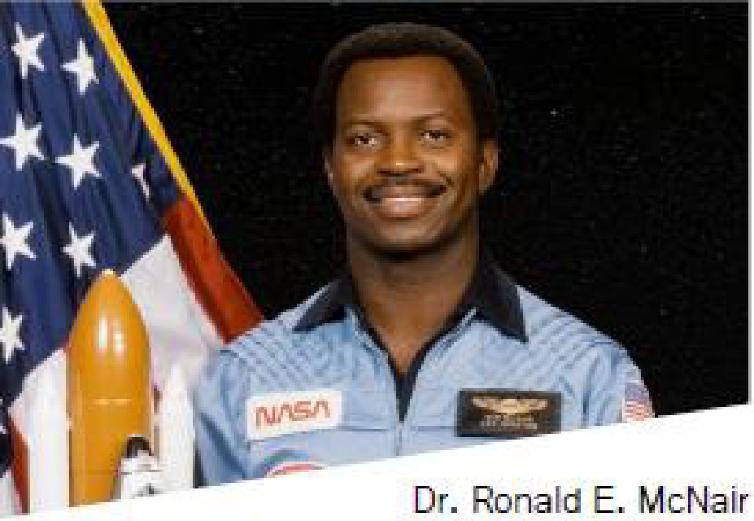
What is the McNair Scholars Program?
In 1989 one of the Federal TRIO Programs was named after NASA Astronaut Dr. Ronald E. McNair to prepare low income, first generation and underrepresented students for doctoral studies through research and other scholarly activities. To be eligible students meet all of the following criteria:
Be a first-generation college student (neither of the student’s parents completed a bachelor’s degree).
Qualify as low-income as defined by federal income guidelines.
Be an underrepresented undergraduate student (defined as “an individual who is a member of groups underrepresented including Blacks, Hispanics, American Indians, Alaskan Natives, and Pacific Islanders, (Including Native Hawaiians”)

Slide 4
The McNair Scholars Program Does?
Scholar orientation
Conduct research
Meetings with mentor
McNair workshops and events
McNair presentation and research poster conferences
Graduate school awareness
Graduate application/GRE assistance

Slide 5
Faculty Mentors & McNair
Noted benefits:
Pleasure of passing on knowledge and skill
Reward of seeing a student’s growth under your guidance
Excitement from learning from students and making joint discoveries
https://mediahub.unl.edu/media/18357

Slide 6
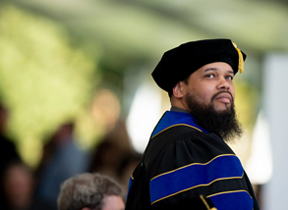
Expectations of Faculty Mentors
Mentoring students underdeveloped in their research and creative projects entails responsibilities: You will be asked to:
Set high standards for performance for both the student and yourself
Give positive support, not just negative criticism
Assess your student’s ability realistically; offer special opportunities such as conference or co-publishing as appropriate, but don’t hold out false hopes
Enjoy the process of working with your student
Source: https://mcnair.wisc.edu/faculty-mentors/

Slide 7
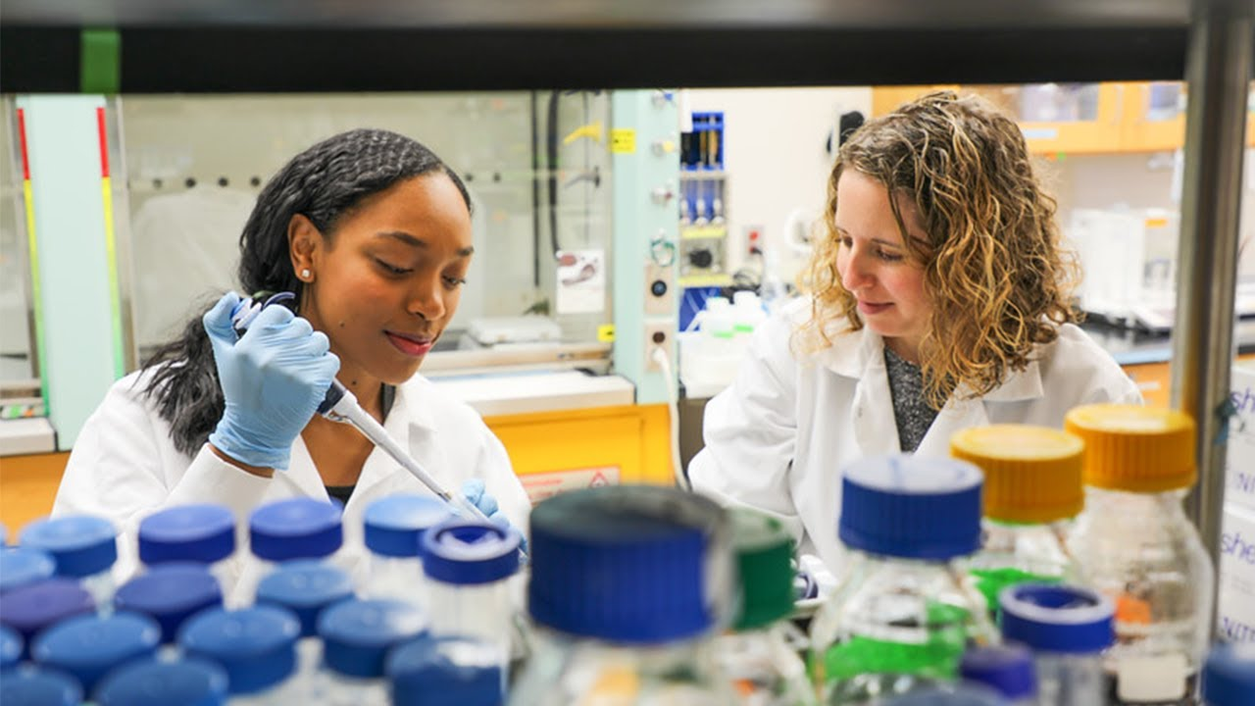
Roles of the Faculty Mentor
Advisors: people with career experience willing to share their knowledge
Supporters: people who give emotional and moral encouragement
Tutors: people who give specific feedback on one’s performance
Sponsors: sources of information about and aid in obtaining opportunities
Role models: of the kind of person one should be in an academic setting
Source: https://mcnair.wisc.edu/faculty-mentors/

Slide 8
Responsibilities of the Faculty Mentor
Work closely with the scholar, meeting regularly
Update McNair staff on student progress
Assist student in the development of research action plan
Serve as instructor, guiding the identification, design, and the completion of appropriate research work (ex. Abstract, introduction, lit. review, methodology, results, conclusion, etc.)
Give constructive and critical review of all of the components of the scholar’s research project
Assist the scholar in preparing and being selected for appropriate presentation(s) of research project
Provide feedback to the McNair Program regarding both the student and the program in general
Source: https://mcnair.wisc.edu/faculty-mentors/

Slide 9
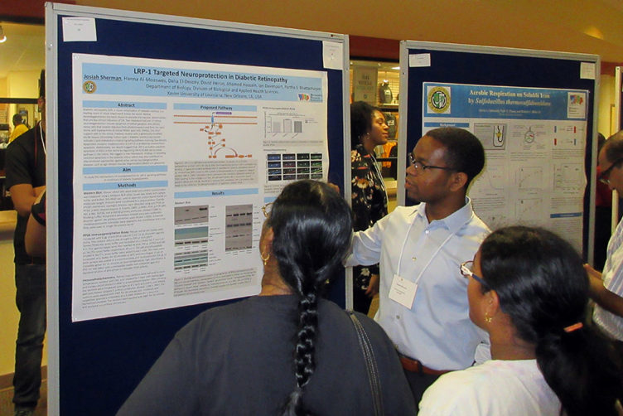
Qualifications for Faculty Mentors
Possess a terminal degree in the appropriate discipline
Have ongoing research or demonstrated research capability of high academic quality
Demonstrate interest in working with low-income, first-generation college students
Other qualities
Supportive of the student pursuing graduate education
Inspire student researchers to reach new academic heights and goals
Source: https://mcnair.wisc.edu/faculty-mentors/

Slide 10
Scholar Recruitment Process
Information Sessions were scheduled all month in October
Students must:
Attend an information session (in-person or virtual)
Complete an application (which includes 1 page personal statement, copy of unofficial transcript, income verification form, and 1 faculty recommendation form) - an application link will be sent to all students who attend an information session
Attend an interview with McNair staff
If student is selected;
They will be registered for the Real 399 course to begin in January
Participate in all McNair sponsored events until graduation
Committed to a career path in which a doctorate is required

Slide 11
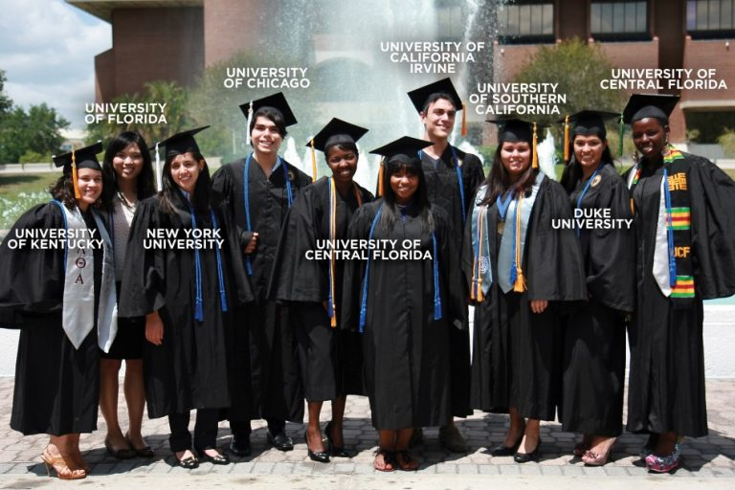
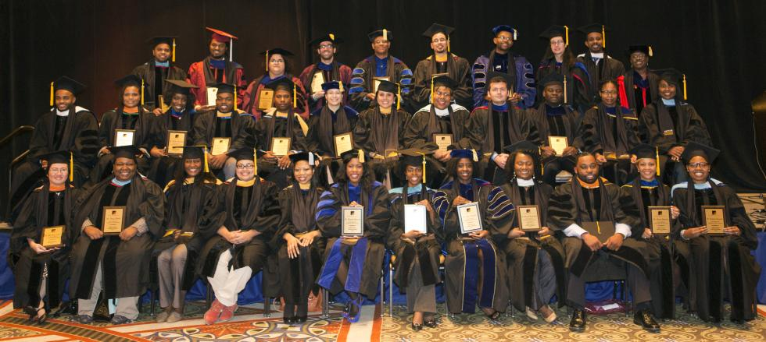
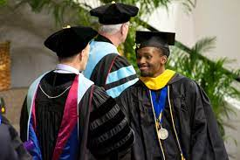
Questions????
Contact us
mcnairscholar@vcu.edu

